Slide 1

Decimals and Fractions
Interactive Notebook
Your Name
Class 7.1 or 7.8
Mrs Riksman
Term 2 Semester 1

Slide 2
Contents
Glossary
Page
Date
Description
Word
Description
4-5
6-7
8-9
10-11
12-13
14-15
16-17
18-19
21/4
28/4
30/4
4/5
6/5
11/5
8/6
9/6
Naming and Comparing Decimals
Adding and Subtracting Decimals
Multiplying Decimals
Dividing Decimals
Converting fractions to decimals
Rounding Decimals
Introduction to fractions
Equivalent Fractions

Slide 3
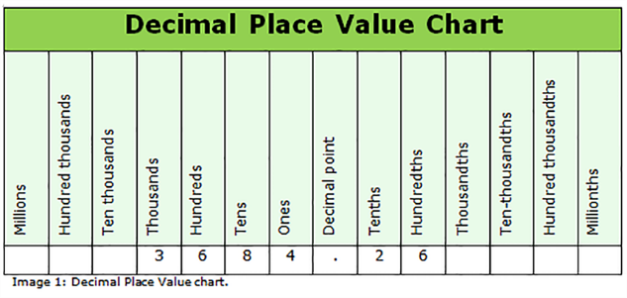
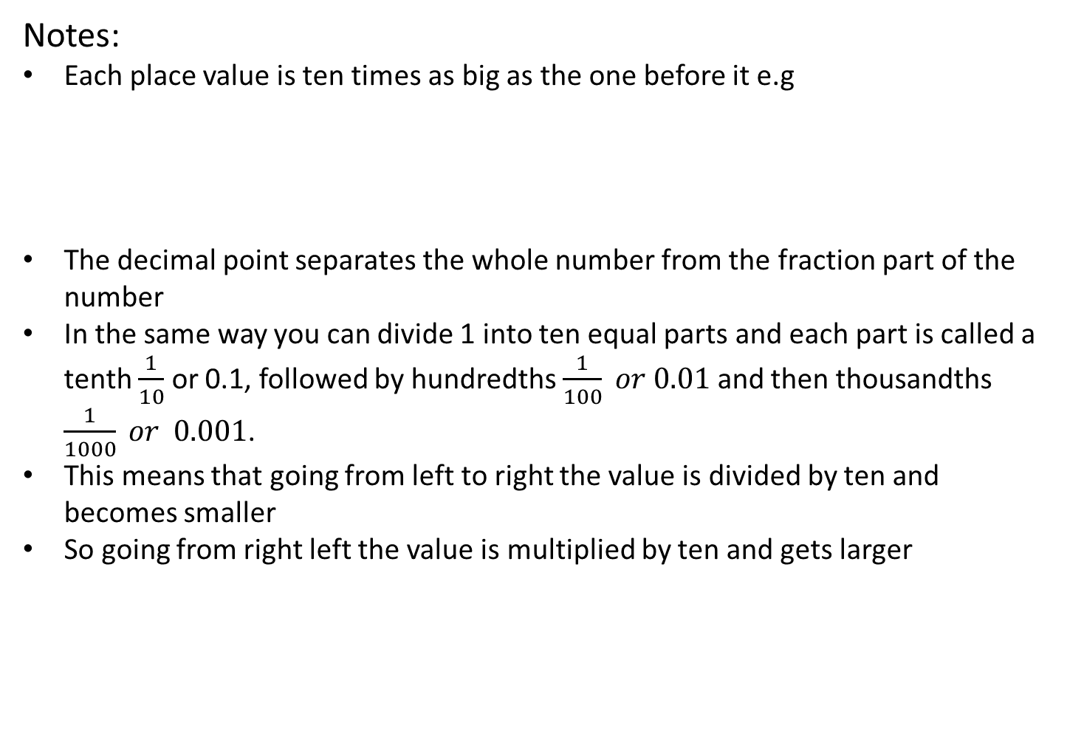
24
7
30
Title: Naming and Comparing Decimals
Date: 21/4/15
EQ : Students need to name each place value to the right of the decimal point and describe the relationship moving in both directions.
Question:
Notes:
Each place value is ten times as big as the one before it e.g
The decimal point separates the whole number from the fraction part of the number
In the same way you can divide 1 into ten equal parts and each part is called a tenth $\frac{1}{10}$ or 0.1, followed by hundredths $\frac{1}{100} or 0.01$ and then thousandths $\frac{1}{1000} or 0.001$.
This means that going from left to right the value is divided by ten and becomes smaller
So going from right left the value is multiplied by ten and gets larger
What does the decimal point do?
Identify the first 3 places after the decimal point
What is the relationship between each number moving in both directions?
5

Slide 4
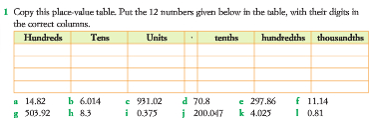
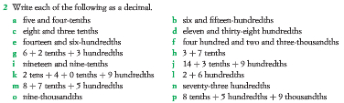
Activities

Slide 5
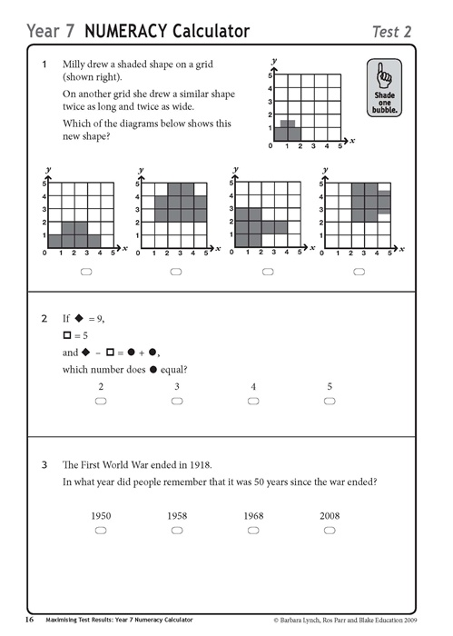
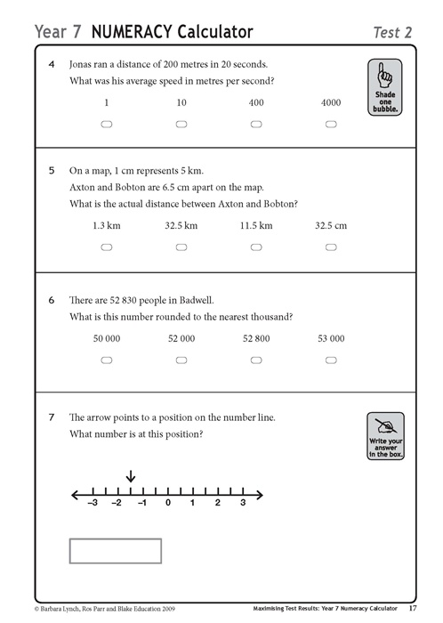

Slide 6
24
7
30
Title: Adding and subtracting decimals
Date:28/4/15
EQ : Describe the written method we use to add and subtract decimals?
Question:
Notes:
To add or subtract decimals, we use methods similar to those for whole numbers.
We use mental strategies for simple cases, especially those where the place values are the same.
The written method of addition and subtraction of decimals:
Put a decimal point at the right end of whole numbers.
Set out vertically with decimal points under each other.
Put zeros on the right end if needed to make all the decimal parts the same length.
Add or subtract as if they were whole numbers.
Put the decimal point in the answer in line with those in the problem.
When is it best to use mental strategies to add and subtract decimals?
List the steps for performing the addition or subtraction of decimals
7

Slide 7
Lets do the following additions together:
  45.78 1.693 713.4 15.672 3.21
+ 3.2 +27.48 + 1.371 +23.15 +14.928
Lets do the following subtractions together:
  2) 29.83 211.693 567.4 115.932 3.21
- 11.1 - 36.27 - 2.32 - 71.41 - 0.728
Now complete Questions 1-12 on page 190 of your textbook

Slide 8
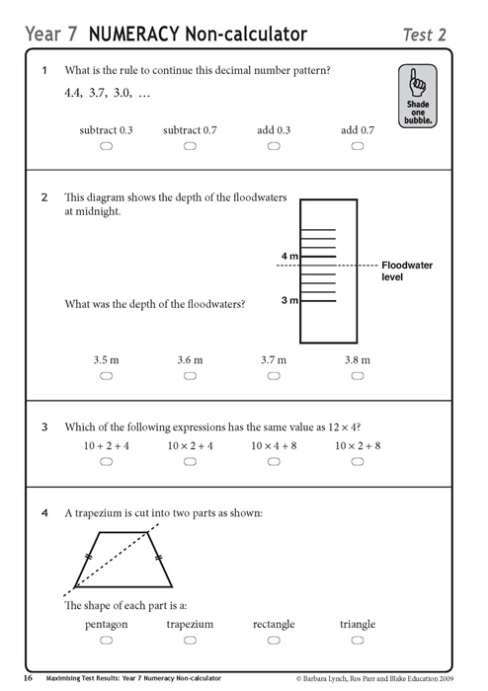
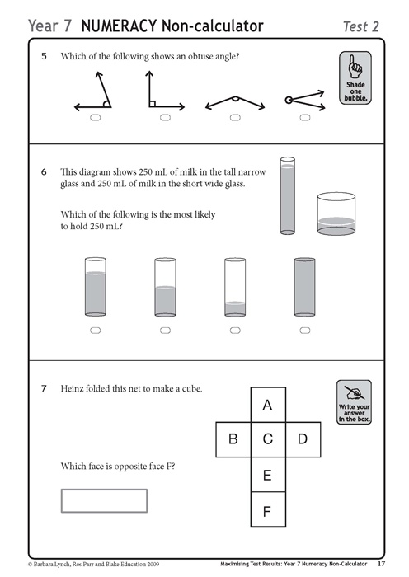

Slide 9
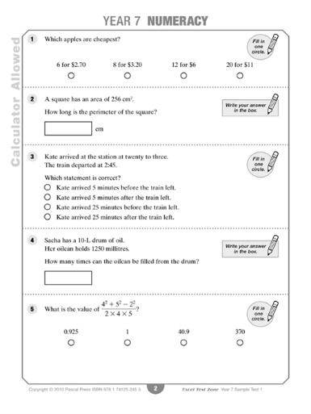
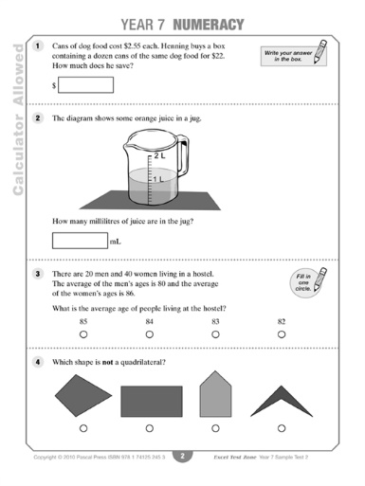

Slide 10
24
7
30
Title: Multiplying decimals
Date:30/4/15
EQ : Describe the method used to multiply decimals . How do we multiply by factors of 10, 100 and 100?
Question:
Notes:
Written multiplication of decimals:
Ignore the decimal points and multiply as whole numbers.
Count the total number of decimal places altogether in the numbers.
Insert the decimal point to give this total number of decimal places in the answer
Example: 6.5 ← 1 decimal place
x0.7 ← 1 decimal place
4.55 2 decimal places
4.56 ← 2 decimal places
x 0.024 ← 3 decimal places
1824
9120
0.10944 5 decimal places
How do we multiply decimals?
9

Slide 11
Question:
Notes:
When multiplying a number by 10, move the decimal point one place to the right
When multiplying a number by 100, move the decimal point two places to the right
When multiplying a number by 1000, move the decimal point three places to the right
Examples: 2.6 x 10 = 26
3.45 x 100 = 345
1.7 x 1000 = 1700
How do we multiply by factors of 10?

Slide 12
Task:
Q1. 3 x 10
Q2. 43 x 10
Q3. 5.6 x 10
Q4. 7 x 100
Q5. 2.3 x 100
Q6. 4.56 x 1000
Q7. 0.49 x 10
Q8. 62 x 10
Q9. 68 x 100
Q10. 5 x 1000
Q11. 5.9 x 10
Q12. 0.32 x 10
Q13. 0.045 x 100

Slide 13
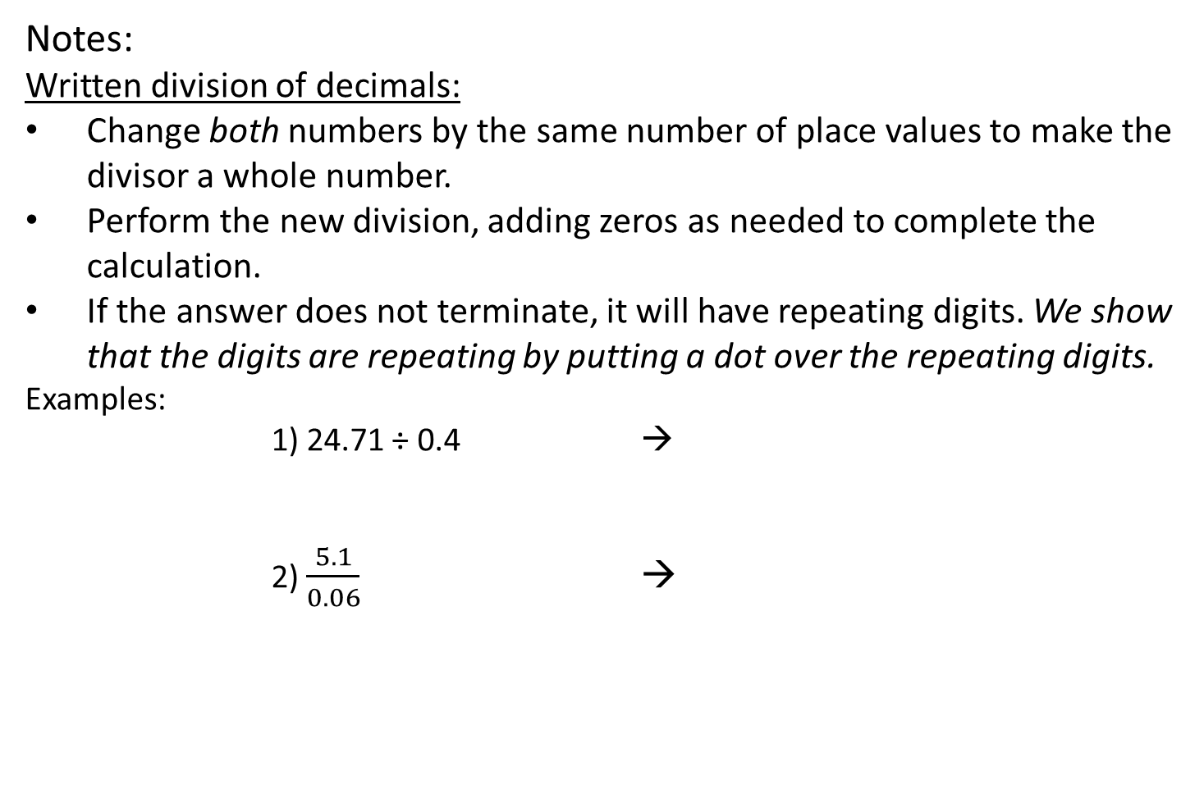
24
7
30
Title: Dividing decimals
Date: 4/5/15
EQ : Describe the method used to divide decimals . How do we divide by factors of 10, 100 and 100?
Question:
Notes:
Written division of decimals:
Change both numbers by the same number of place values to make the divisor a whole number.
Perform the new division, adding zeros as needed to complete the calculation.
If the answer does not terminate, it will have repeating digits. We show that the digits are repeating by putting a dot over the repeating digits.
Examples:
1) 24.71 ÷ 0.4 →
2) $\frac{5.1}{0.06}$ →
How do we divide decimals?
11

Slide 14
Question:
Notes:
When dividing a number by 10, move the decimal point one place to the left.
When dividing a number by 100, move the decimal point two places to the left.
When dividing a number by 1000, move the decimal point three places to the left
Examples: 3.62 ÷ 10 = 0.362
761.8 ÷ 100 = 7.618
139.1 ÷ 1000 = 0.1391
Task: On your left hand task page complete Questions 2-4 on page 197
How do we divide by factors of 10?

Slide 15
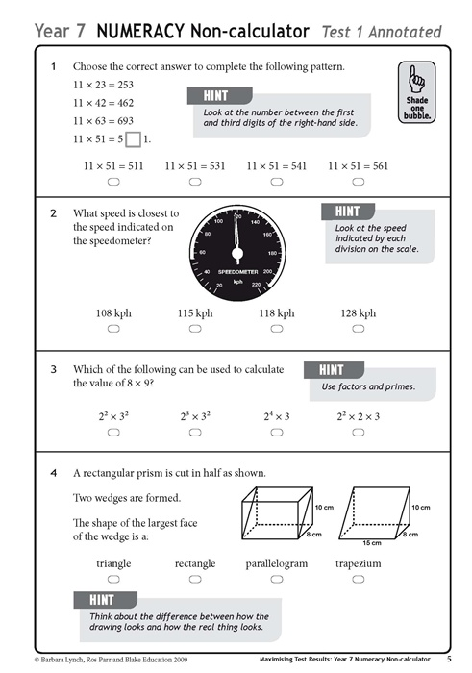
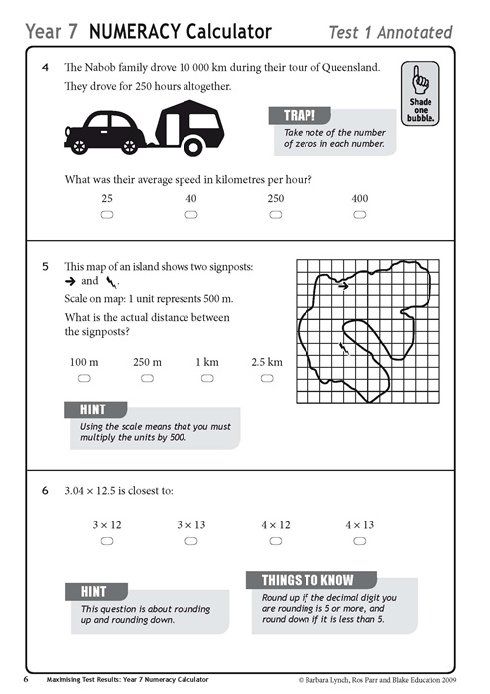

Slide 16
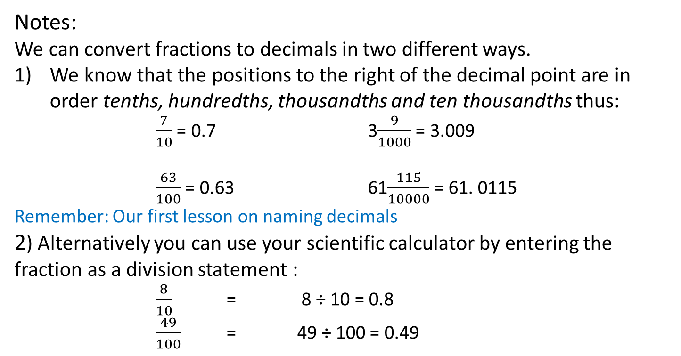
24
7
30
Title: Converting fractions to decimals
Date: 7/5/15
EQ : Describe two ways to convert fractions into decimals.
Question:
Notes:
We can convert fractions to decimals in two different ways.
We know that the positions to the right of the decimal point are in order tenths, hundredths, thousandths and ten thousandths thus:
$\frac{7}{10}$ = 0.7 3$\frac{9}{1000}$ = 3.009
$\frac{63}{100}$ = 0.63 61$\frac{115}{10000}$ = 61. 0115
Remember: Our first lesson on naming decimals
2) Alternatively you can use your scientific calculator by entering the fraction as a division statement :
$\frac{8}{10}$ = 8 ÷ 10 = 0.8
$\frac{49}{100}$ = 49 ÷ 100 = 0.49
How do we use the position of a number in a fraction to write decimals?
How can we use a calculator to convert fractions to decimals
13

Slide 17
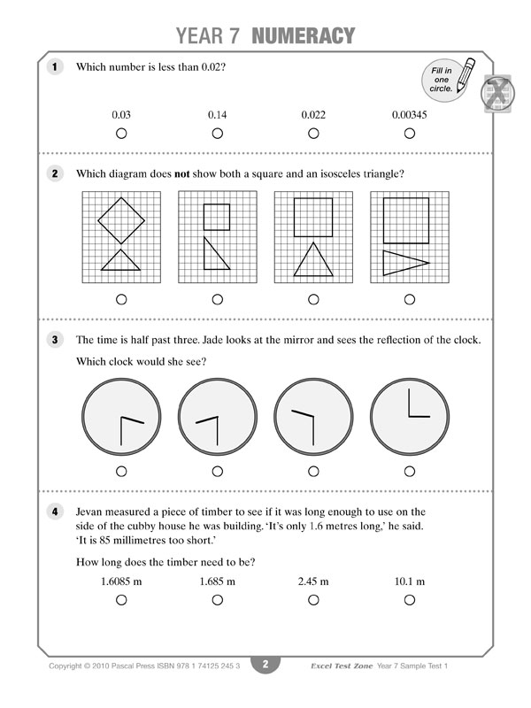

Slide 18
24
7
30
Title: Rounding decimals
Date: 11/5/15
EQ : Describe with an example how to round decimals to a given decimal place
Question:
Notes:
Steps for Rounding decimals
1) Underline the digit to be rounded.
2) Circle the next digit to (the right of) the underlined digit.
3) If the circled digit is less than 5, leave the underlined digit as it is.
4) If the circled digit is 5 or more, round the underlined digit up to the next digit.
5) Leave off the digits after the rounded digit.
Example
Round the following number to 2 decimal places:
34.28 7 b) 4.95 3 c) 167.58 5
Step 4 → 34.29 Step 3 → 4.95 Step 4 → 167.59
What are the steps we take to round decimals?
15

Slide 19
Tasks
Round the following numbers to 1 decimal place (d.p)
a 45.6 3 b 3.4 6 c 145.9 2 d 1001.2 5 e 0.3 9 f 12.8 1
Round the following numbers to 2 decimal places (d.p)
a 123.46 7 b 1.73 1 c 92. 27 2 d 0.19 5 e 10.45 8 f 2057.65 0
g 7. 11 3 h 743. 20 6 i 0.00 9 j 56. 33 4 k 21. 81 1 l 10876. 01 8
Round the following numbers to 3 decimal places (d.p)
a 5. 365 1 b 19. 601 7 c 314. 321 5 d 2082. 100 3 e 0.768 9 f 89.013 6
Use a calculator to round the answers to 2 d.p
a 143 ÷ 7 b 13 ÷ 5.7 c 1076 ÷ 12.8 d 0.897 ÷ 2.1 e 6.43 ÷ 8 f 237 ÷ 4.72
Complete Exercise 4.2 on page 186 questions 6 -12

Slide 20
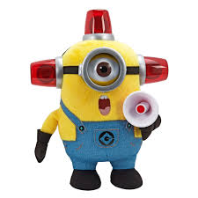
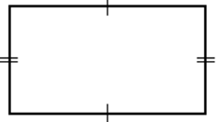

10 Quick Questions
1. 16 x 4 =
2. 1000 – 637 =
3. 481 + 378 =
4. 678 ÷ 6 =
5. $\sqrt{144}$ =
6. 4³
7. $5c −2a+2c$
8. $\frac{1}{6} of 30$
9. Find the perimeter
10. Find the area
19m
7m
4cm
12cm

Slide 21
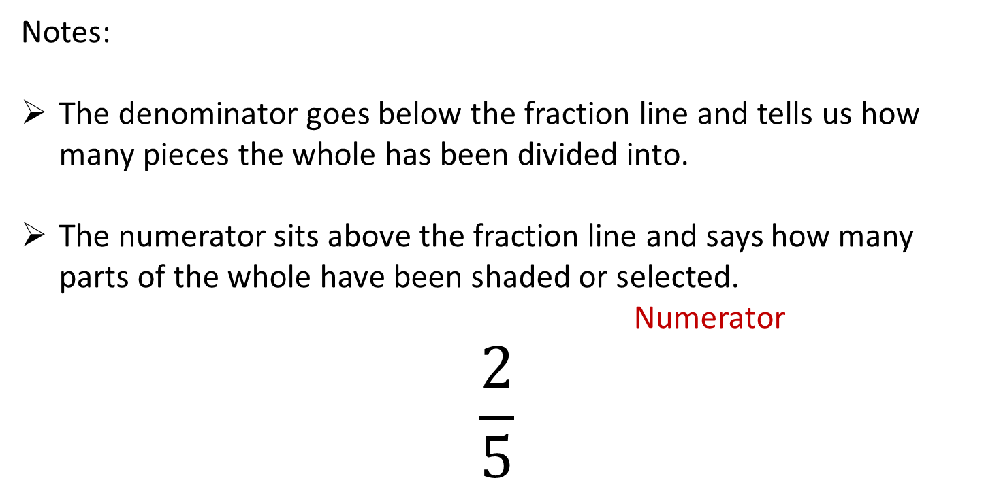
24
7
30
Title: Introduction to fractions
Date: 8/6/15
EQ : Correctly identify and describe the numerator and denominator
Question:
What is the denominator?
What is the numerator?
Notes:
The denominator goes below the fraction line and tells us how many pieces the whole has been divided into.
The numerator sits above the fraction line and says how many parts of the whole have been shaded or selected.
Numerator
$$\frac{2}{5}$$
Denominator
17

Slide 22

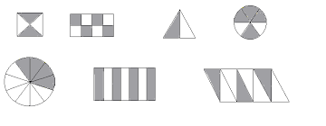
Identify the shaded fraction of the shapes below:

Slide 23

10 Quick Questions
1. 22 x 3 =
2. 1140 – 569 =
3. 756 + 513 =
4. 1293 ÷ 3 =
5. $\sqrt{121}$ =
6. 5³
7. $6z −4y+3z$
8. $\frac{1}{3} of 30$
9. Find the perimeter
10. Find the area
9cm
6cm
7km
4km

Slide 24
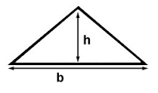

10 Quick Questions
1. 15 x 6 =
2. 1533 – 746 =
3. 1281 + 392 =
4. 678 ÷ 6 =
5. Round 314.76 to 1 d.p
6. How many decimal places in 15.62
7. $8d −2e+4z$
8. $\frac{1}{8} of 40$
9. Find the perimeter
10. Find the area
7m
4m
3m
8cm
4cm

Slide 25
24
7
30
Title: Equivalent fractions
Date: 11/6/15
EQ : What is an equivalent fraction and how can it be calculated?
Question:
What is an equivalent fraction?
What is a common factor and can we use it to find the equivalent fraction
Notes:
Different fractions that are equal in size are called equivalent fractions.
In its simplest form an equivalent fraction has the lowest possible denominator.
A number that goes into both the numerator and the denominator is called a common factor.
In its simplest form, a fraction has no common factors in its numerator and denominator (apart from 1).
19

Slide 26
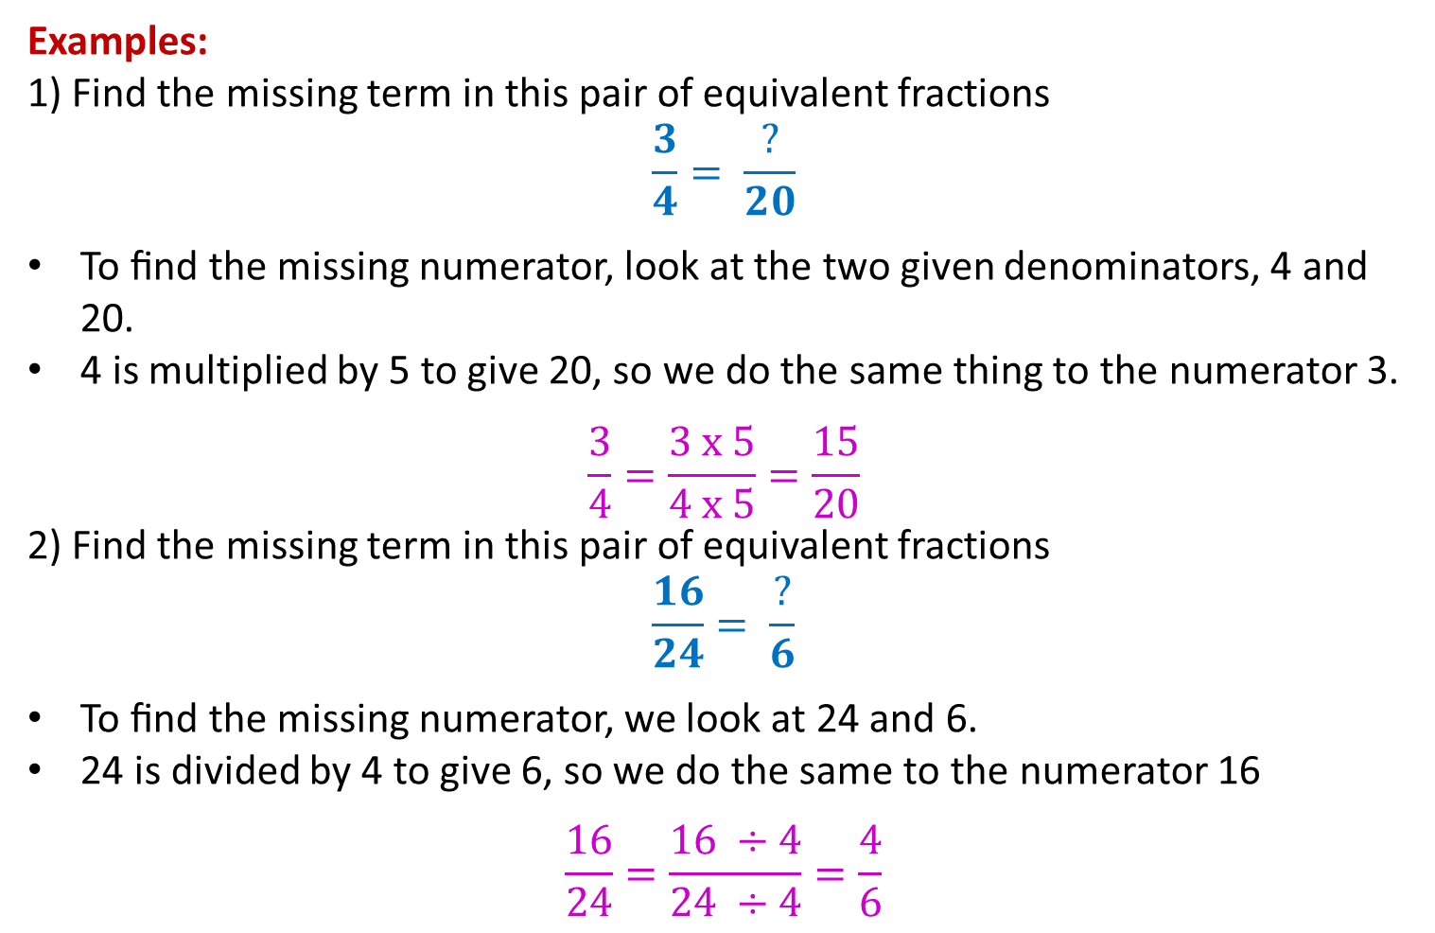
Question:
Notes:
Examples:
1) Find the missing term in this pair of equivalent fractions
$$\frac{3}{4}= \frac{?}{20}$$
To ﬁnd the missing numerator, look at the two given denominators, 4 and 20.
4 is multiplied by 5 to give 20, so we do the same thing to the numerator 3.
$$\frac{3}{4}=\frac{3 x 5}{4 x 5}=\frac{15}{20}$$
2) Find the missing term in this pair of equivalent fractions
$$\frac{16}{24}= \frac{?}{6}$$
To ﬁnd the missing numerator, we look at 24 and 6.
24 is divided by 4 to give 6, so we do the same to the numerator 16
$$\frac{16}{24}=\frac{16 ÷4}{24 ÷4}=\frac{4}{6}$$

Slide 27
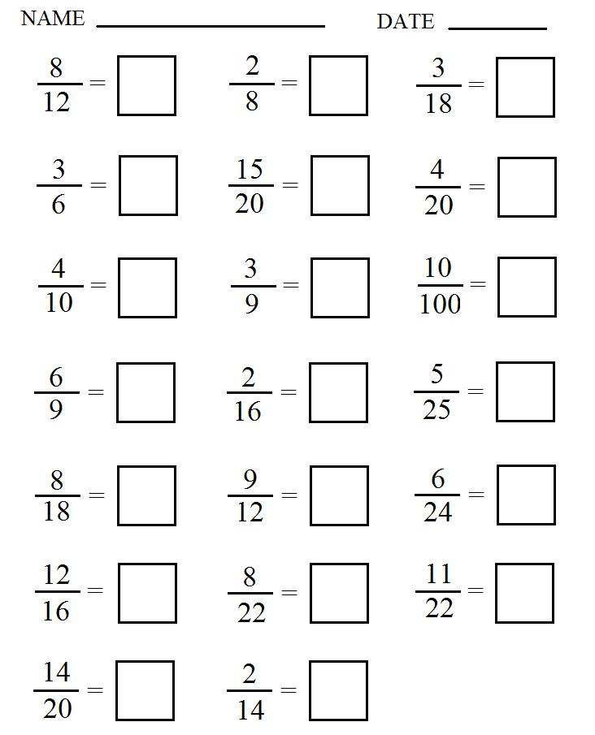

Slide 29

10 Quick Questions
1. 12 x 7 =
2. 1651 – 837 =
3. 1391 + 527 =
4. 678 ÷ 6 =
5. Round 22.57 to 1 d.p
6. How many decimal places in 5.97
7. $3a x 5b$
8. $\frac{1}{8} of$80
9. Find the perimeter
10. Find the area
2mm
3mm
9mm
7m
8m

Slide 30
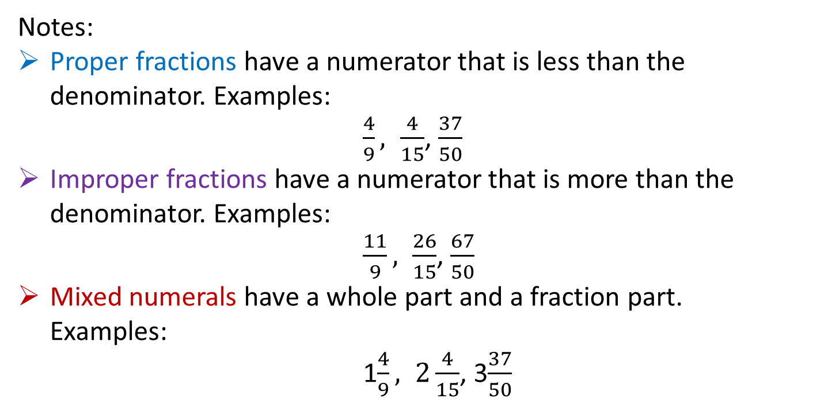
24
7
30
Title: Different types of fractions
Date:
EQ : Identify and describe the three types of fractions proper, improper and mixed numerals.
Question:
Notes:
Proper fractions have a numerator that is less than the denominator. Examples:
$\frac{4}{9}, \frac{4}{15}$, $\frac{37}{50}$
Improper fractions have a numerator that is more than the denominator. Examples:
$\frac{11}{9}, \frac{26}{15}$, $\frac{67}{50}$
Mixed numerals have a whole part and a fraction part.
Examples:
1$\frac{4}{9}, 2\frac{4}{15}$, 3$\frac{37}{50}$
What is a proper fraction?
What is an improper fraction?
What is a mixed numeral?
21

Slide 31
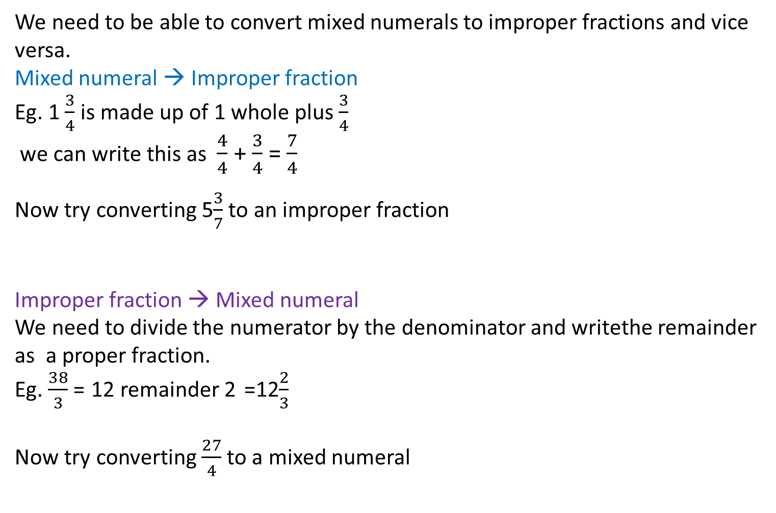
Question:
Notes:
We need to be able to convert mixed numerals to improper fractions and vice versa.
Mixed numeral → Improper fraction
Eg. 1 $\frac{3}{4}$ is made up of 1 whole plus $\frac{3}{4}$
we can write this as $\frac{4}{4}$ + $\frac{3}{4}$ = $\frac{7}{4}$
Now try converting 5$\frac{3}{7}$ to an improper fraction
Improper fraction → Mixed numeral
We need to divide the numerator by the denominator and writethe remainder as a proper fraction.
Eg. $\frac{38}{3}$ = 12 remainder 2 =12$\frac{2}{3}$
Now try converting $\frac{27}{4}$to a mixed numeral
How do we convert a mixed numeral to an improper fraction?
How do we convert an improper fraction to a mixed numeral?

Slide 32

10 Quick Questions
1. 17 x 6 =
2. 1341 – 978 =
3. 1769 + 635 =
4. 224 ÷ 7 =
5. Round 76.61 to 1 d.p
6. How many decimal places in 15.724
7. $3a+ 5b+2a$
8. $\frac{1}{9} of 54$
9. Find the perimeter
10. Find the area
4m
3m
15m
8cm
12cm

Slide 33
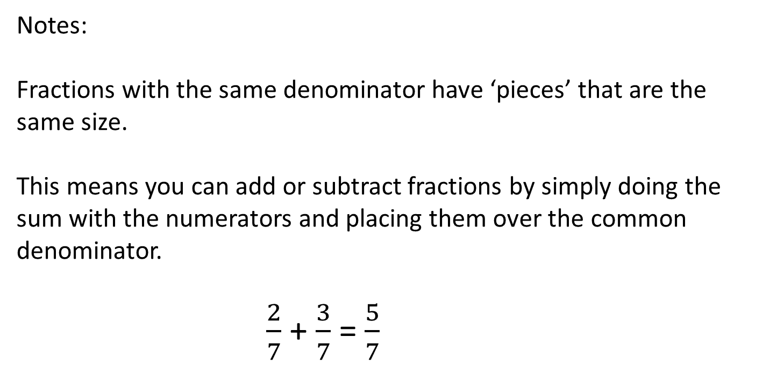
24
7
30
Title: Adding and Subtracting Fractions with
the same Denominator
EQ : Explain the process of adding and subtracting fractions with the same denominator
Question:
Notes:
Fractions with the same denominator have ‘pieces’ that are the same size.
This means you can add or subtract fractions by simply doing the sum with the numerators and placing them over the common denominator.
$\frac{2}{7}$ + $\frac{3}{7}$ = $\frac{5}{7}$
How do you add or subtract fractions with the same denominator?
Do the sum with the numerators
Place over the common denominator
23

Slide 34

Question:
Notes:
Examples:
1.
$\frac{3}{9}$ + $\frac{4}{9}$ = $\frac{7}{9}$
2. $\frac{12}{15}$ + $\frac{9}{15}$ = $\frac{21}{15 }$ = 1$\frac{6}{15}$
3. $\frac{23}{16}$ - $\frac{5}{16}$ = $\frac{18}{16 }$ = $\frac{9}{8}$ = 1$\frac{1}{8}$
Remember to convert an improper fraction to a mixed numeral we need to divide the numerator by the denominator and write the remainder as a proper fraction.
Eg. $\frac{38}{3}$ = 12 remainder 2 = 12$\frac{2}{3}$
23

Slide 35
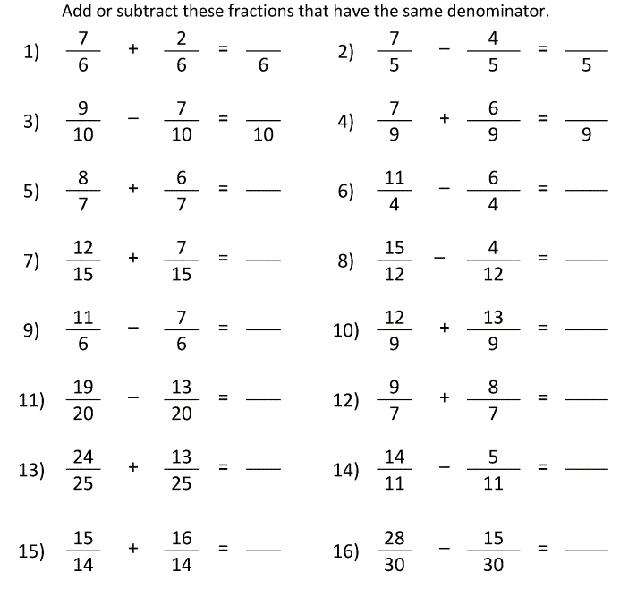

Slide 36
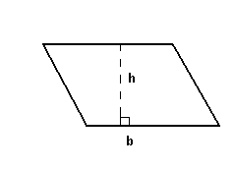

10 Quick Questions
1. 23 x 5 =
2. 2165 – 889 =
3. 1912 + 796 =
4. 5624 ÷ 8 =
5. Round 103.874 to 2 d.p
6. Round 387 to the nearest hundred
7. $4c x 3d$
8. $\frac{1}{7} of 63$
9. Find the perimeter
10. Find the area
7cm
3cm
4m
8m

Slide 37
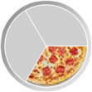
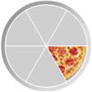

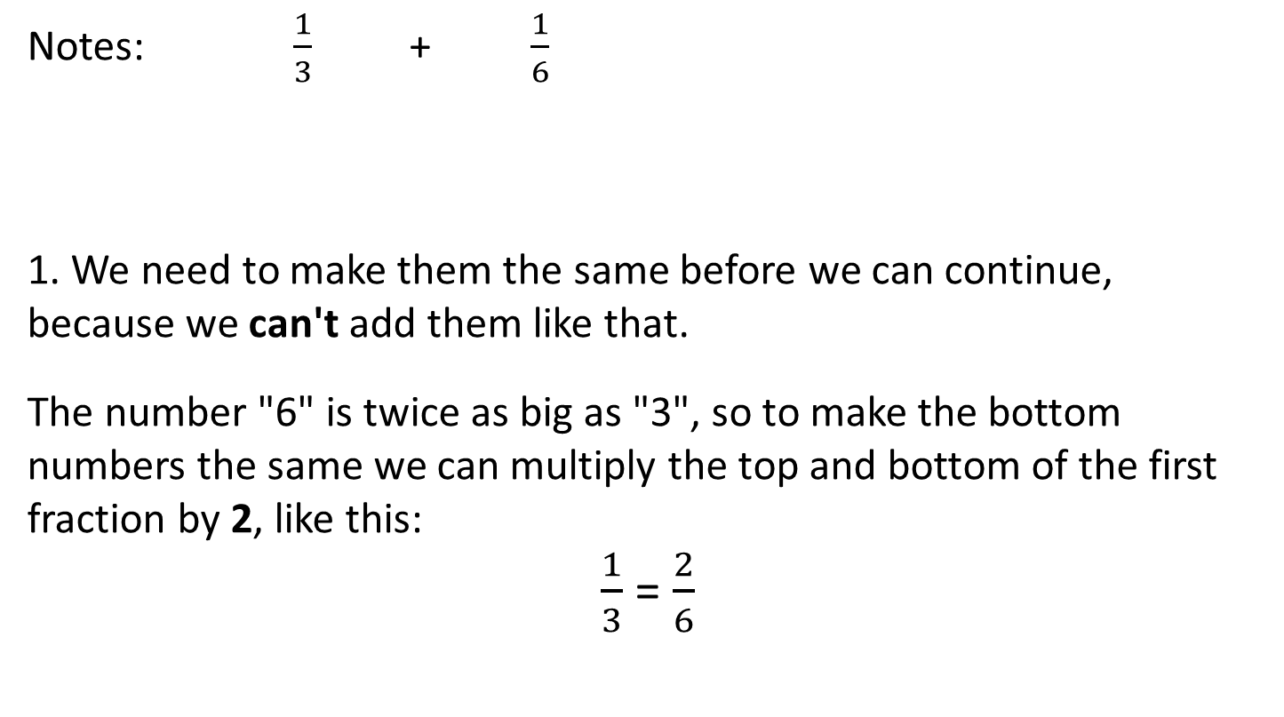
24
7
30
Title: Adding and Subtracting Fractions with
the Related Denominators
EQ : Explain the process of adding and subtracting fractions with the related denominators
Question:
Notes: $\frac{1}{3}$+ $\frac{1}{6}$
1. We need to make them the same before we can continue, because we can't add them like that.
The number "6" is twice as big as "3", so to make the bottom numbers the same we can multiply the top and bottom of the first fraction by 2, like this:
$\frac{1}{3}$ = $\frac{2}{6}$
+
=
What is the first step in the process?
How do we convert the numerator and denominator?
x2
x2
25

Slide 38
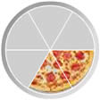
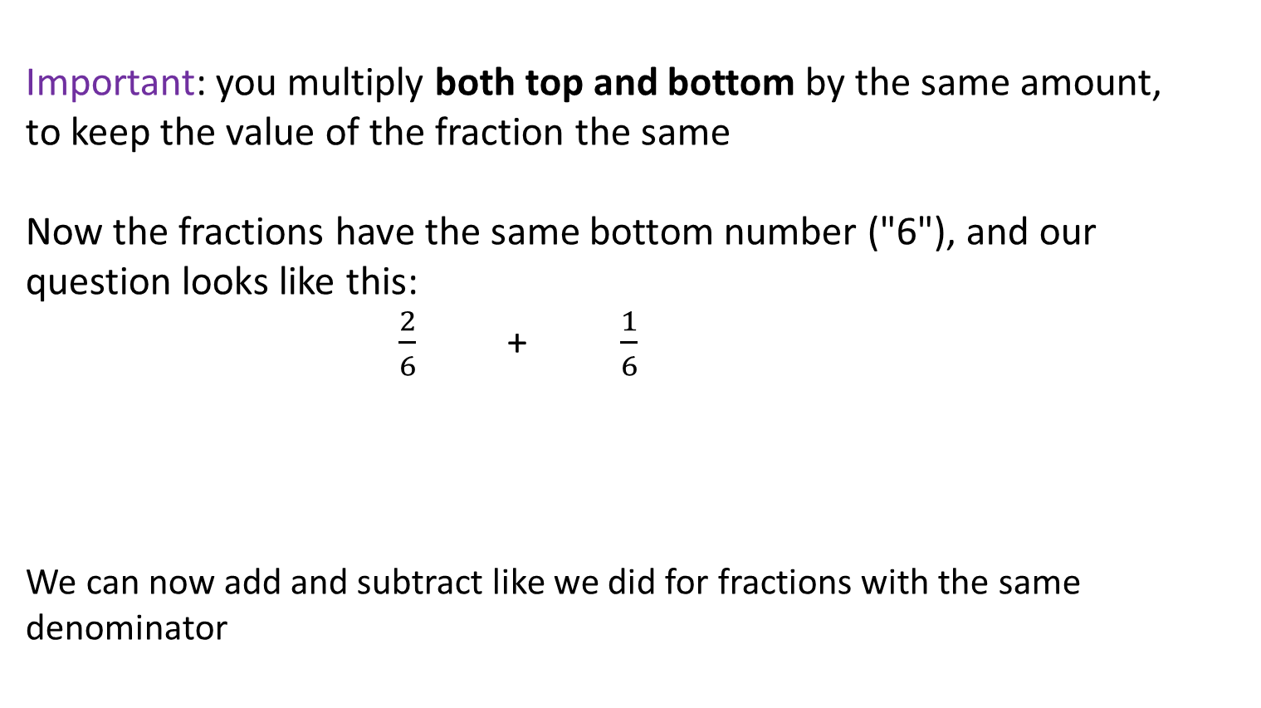
Question:
Notes:
Important: you multiply both top and bottom by the same amount,
to keep the value of the fraction the same
Now the fractions have the same bottom number ("6"), and our question looks like this:
$\frac{2}{6}$+ $\frac{1}{6}$
We can now add and subtract like we did for fractions with the same denominator
Why do we multiply both the top and bottom?
What is the final step?
25

Slide 39

10 Quick Questions
1. 31 x 6 =
2. 2352 – 768 =
3. 2124 + 971 =
4. 56714 ÷ 7 =
5. Round 52.1982 to 2 d.p
6. Round 576 to the nearest ten
7. $4a+6c −3a$
8. $\frac{3}{4} of 32$
9. Find the perimeter
10. Find the area
6mm
3mm
7cm
9cm

Slide 40

10 Quick Questions
1. 43 x 8 =
2. 3268 – 892=
3. 3817 + 1492 =
4. 5648 ÷ 8 =
5. Round to 0.98725 3 d.p
6. Write 3 hundredths as a fraction
7. $\frac{2}{5 }$ + $\frac{3}{4}$
8. $\frac{4}{5} of 45$
9. $\frac{3}{5 }$ - $\frac{1}{4}$
10. Find the area
9m
12m

Slide 41
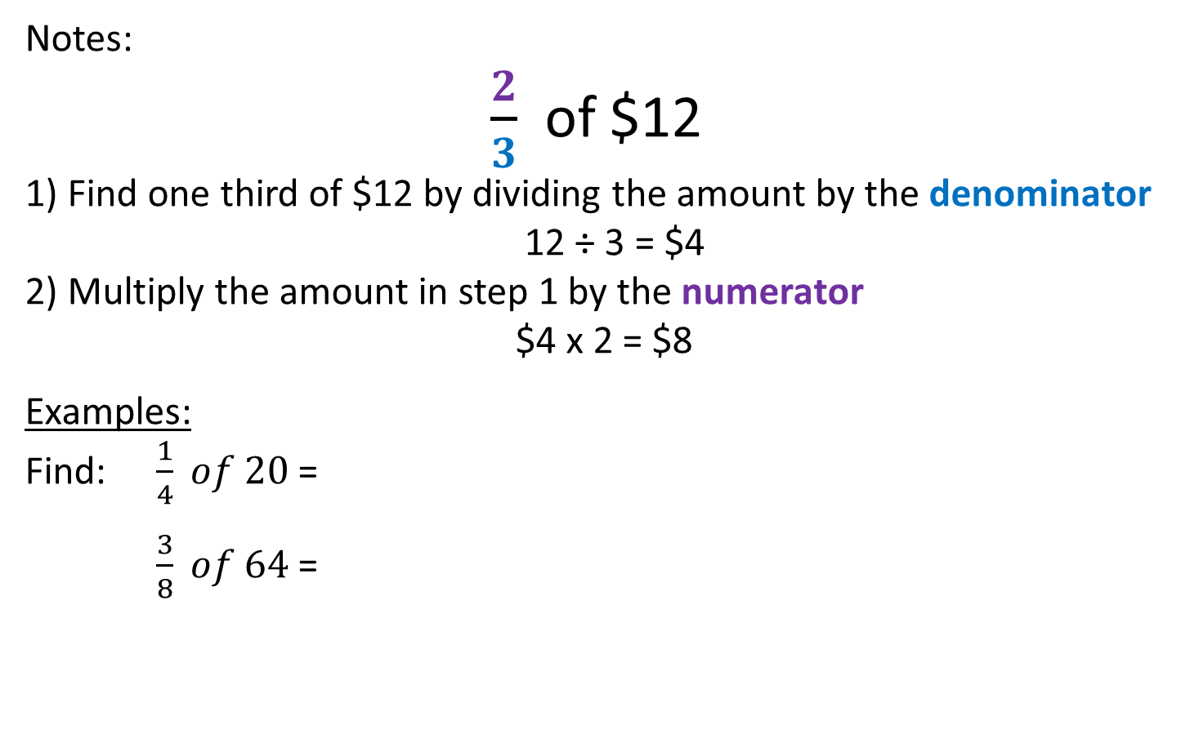
24
7
30
Title: Finding fractions of an amount and
Multiplying Fractions
EQ : Explain how to find the fraction of an amount and the process of multiplying fractions
Question:
Notes:
$\frac{2}{3}$ of $12
1) Find one third of $12 by dividing the amount by the denominator
12 ÷ 3 = $4
2) Multiply the amount in step 1 by the numerator
$4 x 2 = $8
Examples:
Find: $\frac{1}{4} of 20$ =
$\frac{3}{8} of 64$ =
How do you find a fraction of an amount?
27

Slide 42
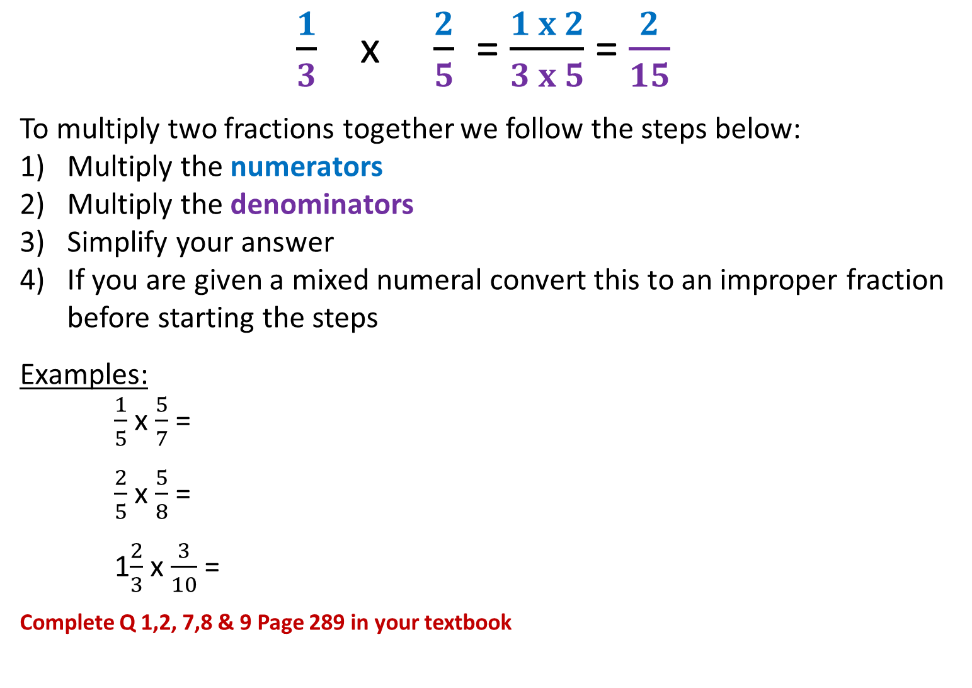
Question:
Notes:
$\frac{1}{3}$ x $\frac{2}{5}$ = $\frac{1 x 2}{3 x 5}$ = $\frac{2}{15}$
To multiply two fractions together we follow the steps below:
Multiply the numerators
Multiply the denominators
Simplify your answer
If you are given a mixed numeral convert this to an improper fraction before starting the steps
Examples:
$\frac{1}{5}$ x $\frac{5}{7}$ =
$\frac{2}{5}$ x $\frac{5}{8}$ =
1$\frac{2}{3}$ x $\frac{3}{10}$ =
Complete Q 1,2, 7,8 & 9 Page 289 in your textbook
What are the steps to multiply two fractions?
27

Slide 43

10 Quick Questions
1. 62 x 5 =
2. 3362 – 1887 =
3. 3470 + 1768 =
4. 60186 ÷ 6 =
5. Round to 1.98 to 1 d.p
6. Write 5 tenths as a fraction
7. $\frac{5}{9} of 81$
8. Write a fraction equivalent to $\frac{4}{5}$
9. $\frac{1}{3}+ \frac{2}{5}$
10. $\frac{4}{5}− \frac{2}{7}$

